Slide 1
Twitter text analysis for Disaster management
Project 7
Submitted by –Ajit Kumar

Slide 2
Project Overview
Background-
In the digital era, social media platforms like Twitter are pivotal in disseminating real-time information, particularly during emergencies and disasters. However, distinguishing tweets that genuinely indicate disasters from unrelated ones poses a significant challenge, even for humans. Organizations such as disaster relief agencies and news outlets are keenly interested in developing automated methods to monitor Twitter for real-time disaster alerts.
Challenge-
The primary challenge is to develop a machine learning model capable of accurately classifying tweets as related to real disasters or not. The nuanced and context-dependent nature of tweets, where terms like “fire” or “flood” may be used metaphorically, adds complexity to the task. The model must reliably discern the true intent behind the language used .
Objectives-
1. Classification Model Development: Build a machine learning model to classify tweets as disaster-related or not
2. Accuracy and Precision: Ensure high accuracy & precision in predictions to minimize false alarms and optimize disaster response.
3.Robustness: Design a model resilient to language variations such as slang, abbreviations, and cultural nuances.
4.Scalability: Create a scalable system capable of processing large volumes of tweets in real-time.

Slide 3
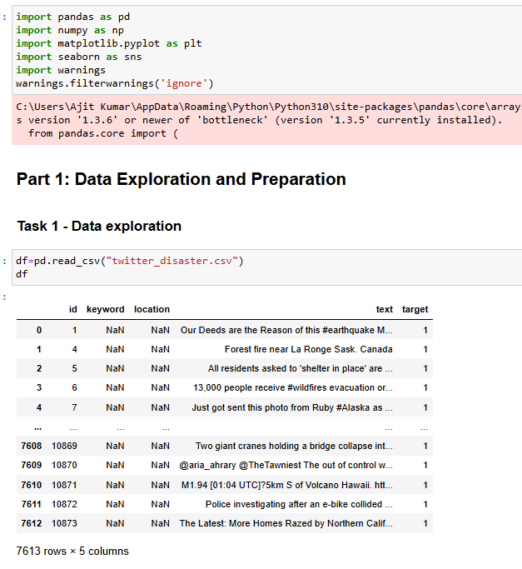
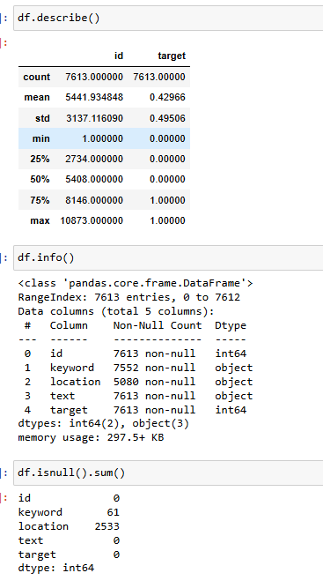
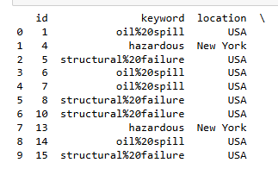
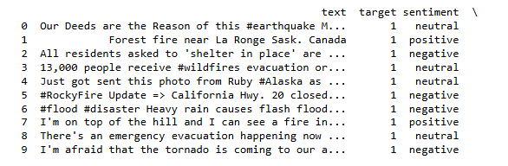
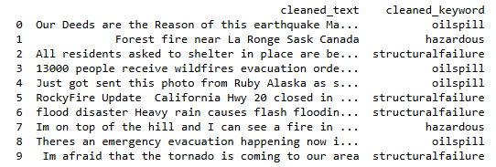
Data preprocessing and exploration

Slide 4
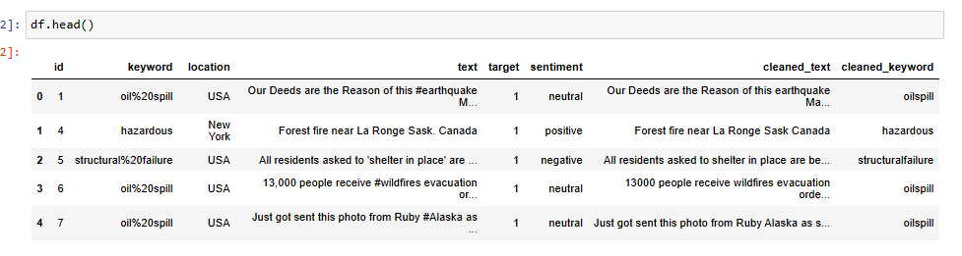
Data preprocessing and exploration
Analysis-
1.Data frame has two integer type and three object type feature.
2.Special characters , null values , presence in features like ‘Keyword’,”Location”,and “Text”.
3. Null values have been replaced based on most common keyword associated with the rows sentiment.
Analysis
1.Text Blob to classify the sentiments as positive , negative or neutral based on polarity.
2.Group by sentiment and get the most frequent keyword and location for each sentiment.
3. URL, special characters , Extra white space were removed using split method.
4.Separate column cleaned_text and cleaned_keyword were created for the dataframe

Slide 5
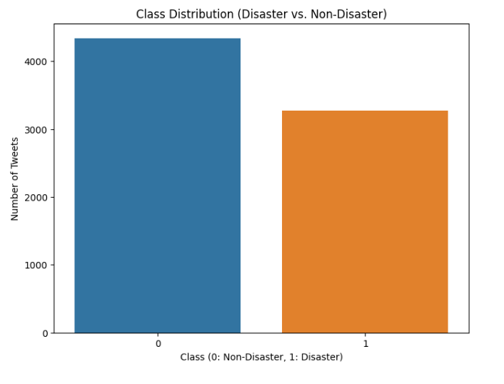
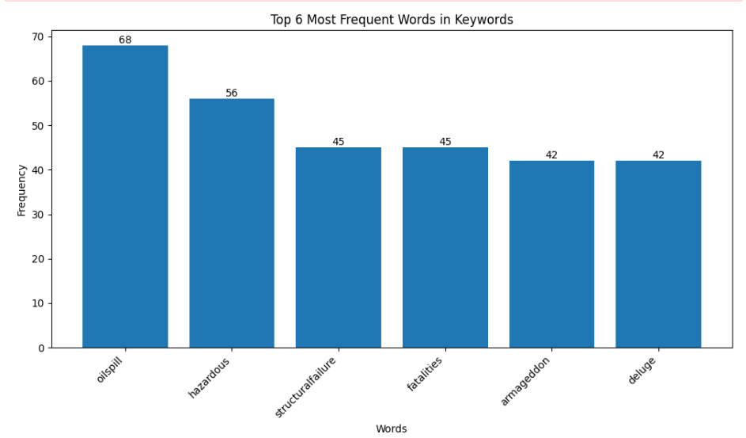
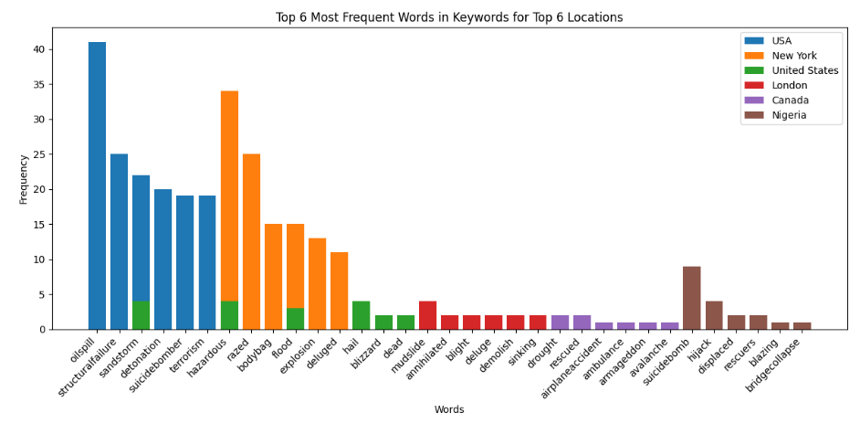
Data visualization
Bar plot for most frequent used words-
Oil spill , hazardous and structural failure were top three frequently used words.
More tweets for non disaster while less tweets for disaster related.
Bar plot for most frequent used words location wise

Slide 6
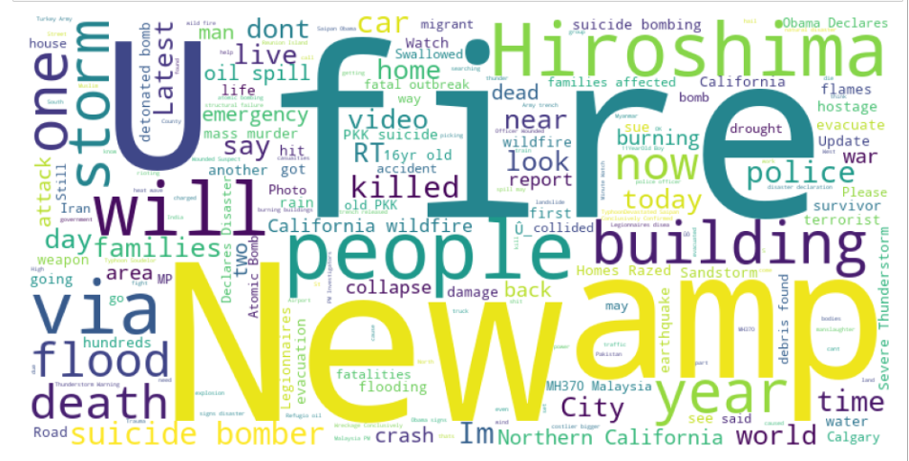
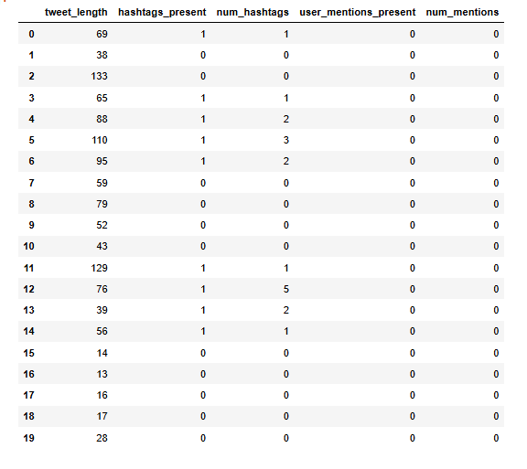
Word cloud
Feature Extraction
Analysis-
Lemmatization have been applied on the clean_text feature after Post Tokenization ,
Word cloud has been formed on the disaster related tweet.
Fire people , Hiroshima , amp, people , building were few of the words
Analysis-
The text feature of the data frame has been broken down into several fields: tweet length, hashtag presence, number of hashtags, user mentions, and number of mentions
The tweet length was calculated, while the presence of hashtags and user mentions were marked as 1, and their absence as 0
Num_hashtags and num_mentions have been calculated

Slide 7
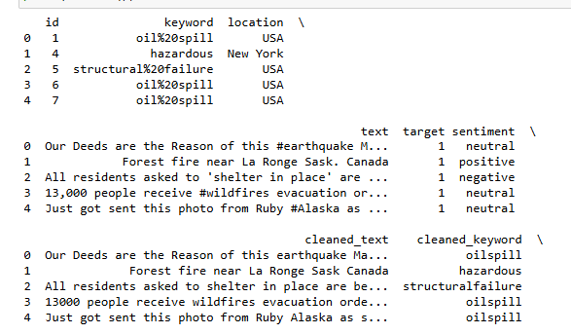
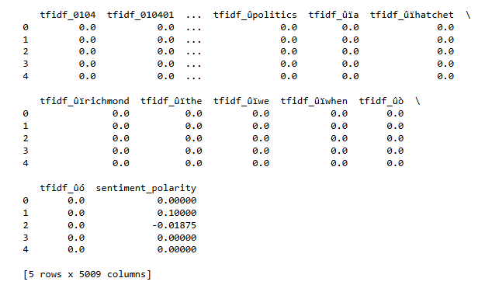
TF-IDF and sentiment analysis
Analysis-
Sentiment analysis has been applied on lemmatized text
Sentiment classified into disaster and non-disaster
Disatser related tweets has target-1. Code performs sentiment analysis on the “ cleaned_text” using get_sentiment_words function. For positive sentiments is set as “yes” otherwise its set as “no”
Similarly, for non-disaster tweets target is 0.
Analysis-
1.Pre trained word embedding has been imported
2.Tokenization has been applied on the text feature and average embeddings were found.
3.Numerical vectors capture the semantic meaning of words, allowing words with similar meanings to have similar vector representations have been shown for each row under embeddings

Slide 8
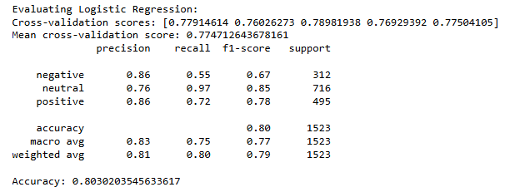
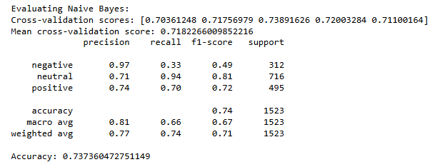
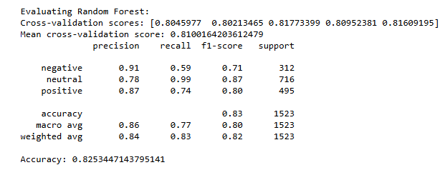
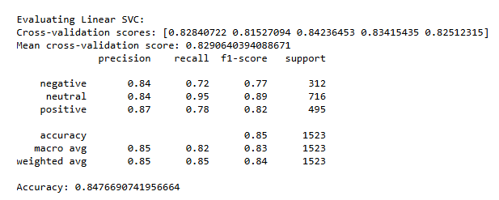
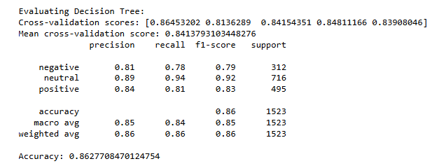
Model evaluation and validation
Analysis-
1.Five models have been evaluated Logistic , SVC, and Naïve Bayes, Random forest and Decision tree
2.F1- score and Mean CV score provides a balance between precision and recall , making it a good overall metric. The mean cross validation score indicates how well the model generalizes to unseen data.
3.Choose the model with the highest F1 score and a good Mean CV score. This will likely be your best performing model. (Linear SVC and Decision tree for both disaster and non disaster related tweet)

Slide 9
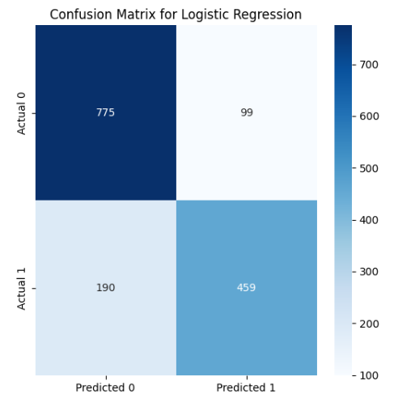
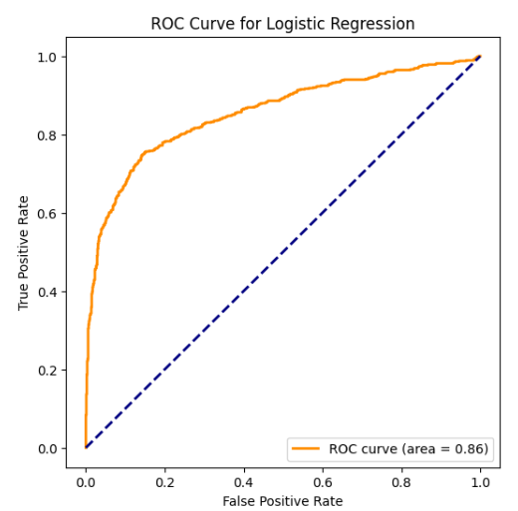
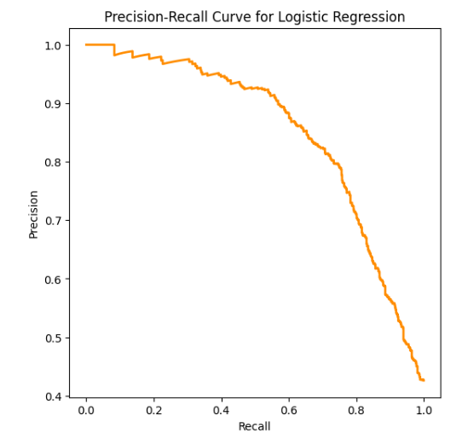
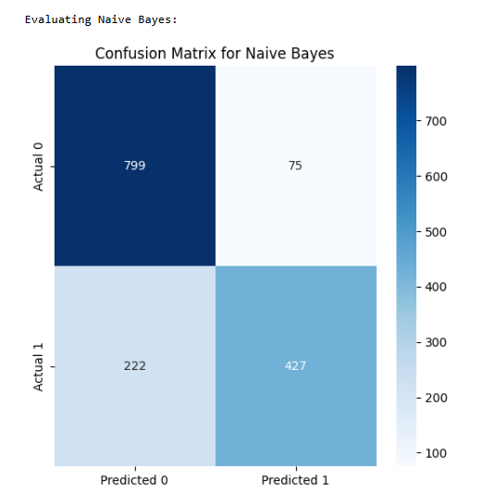
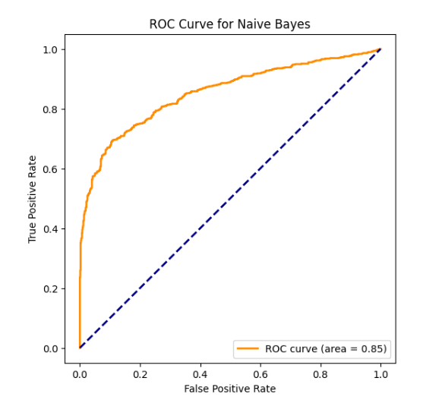
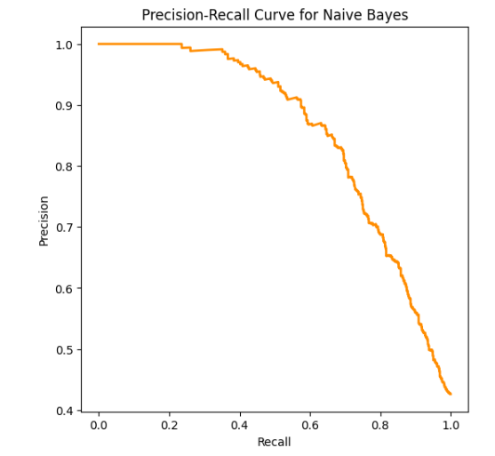
Model comparison
Analysis
1.Confusion Matrix-
It summarizes the performance of a classification model of True positives , true negatives , false negatives and false positives.
2.High precision means the model makes few false positives predictions.
3.High recall means the model identifies most of the actual positive cases
4. There’s often a trade off between precision and recall.

Slide 10
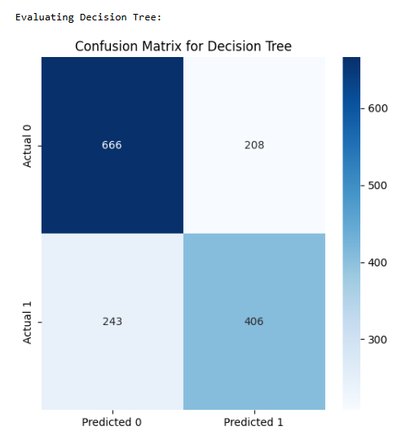
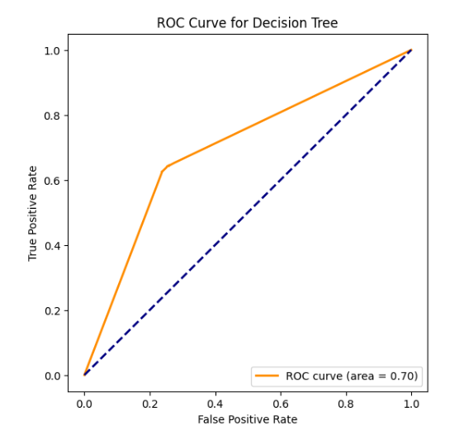
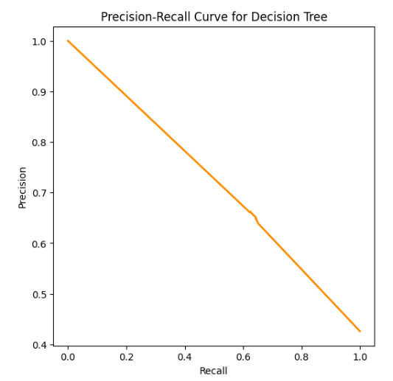
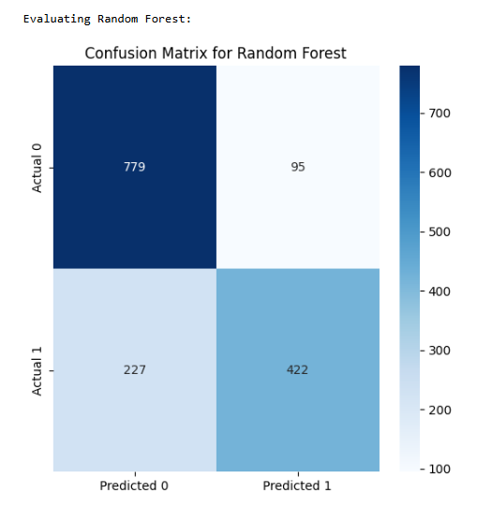
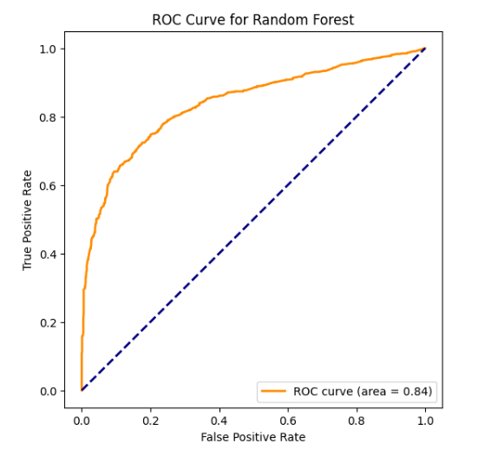
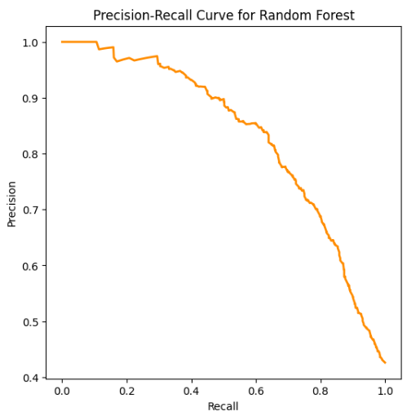
A
Analysis
1.Confusion Matrix-
It summarizes the performance of a classification model of True positives , true negatives , false negatives and false positives.
2.High precision means the model makes few false positives predictions.
3.High recall means the model identifies most of the actual positive cases
4. There’s often a trade off between precision and recall.

Slide 11
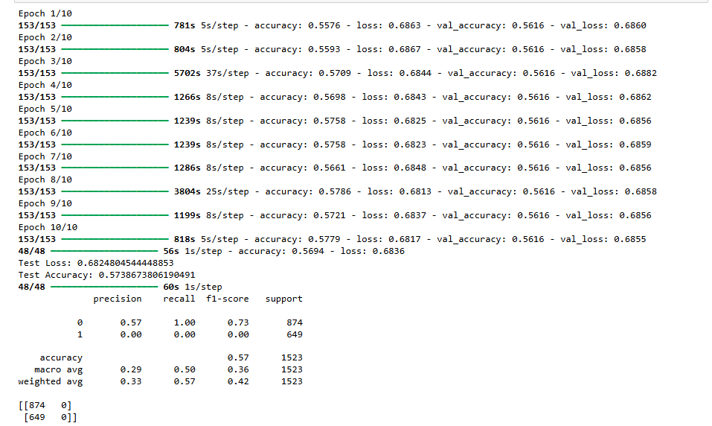
Model evaluation and comparison
Analysis-
1.Model is learning as we can see training accuracy is increasing and training accuracy is decreasing from 1st to 2nd EPOCH.
2.More EPOCH may improve the model

Slide 12
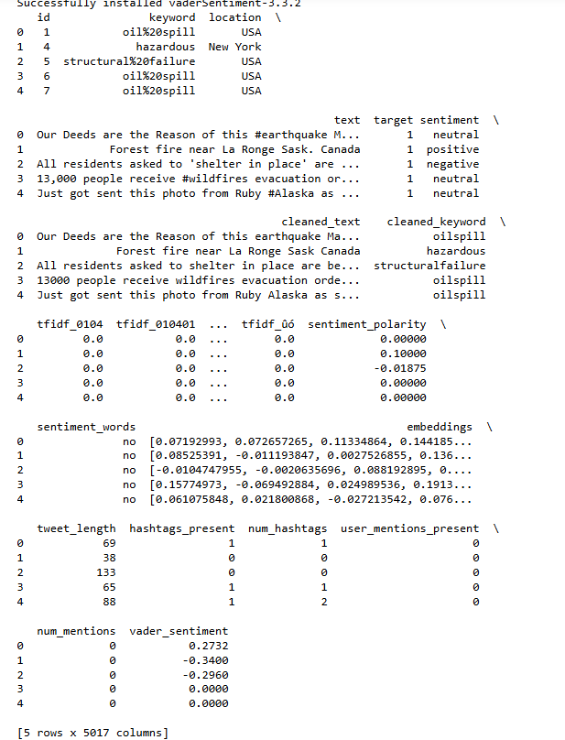
Vader analysis
Vader sentiments helps in quickly assessing the sentiments of texts in tweets and classify based on events as in this case disaster related or non disaster related

Slide 13
THANK YOU !

